Slide 1
OKCupid – Machine Learning Analysis
By Faatimah majothi

Slide 2

Introduction

Slide 3
Overview
OKCupid is an app that focuses on using multiple choice and short answers to match users.
In this project, we used machine learning to predict whether a user is a smoker, based on profile details like age, interests, and lifestyle habits.
We built and tested classification models to measure how well they predict smoker status.
Our hypothesis was that user characteristics are not strong predictors of a lifestyle choice such as smoking.

Slide 4
“In recent years, there has been a massive rise in the usage of dating apps to find love. Many of these apps use sophisticated data science techniques to recommend possible matches to users and to optimize the user experience. These apps give us access to a wealth of information that we’ve never had before about how different people experience romance.” – Codecademy

Slide 5
Project Goals
EDA
Data preprocessing
Model building
Model evaluation
Analysis

Slide 6

EDA
Exploratory Data Analysis

Slide 7
The Dataset
Overview
The OKCupid dataset, profiles.csv, contained over 59,946 rows of user data. Most features were short answers to multiple-choice questions, while some were unrestricted essay responses. As the essay questions were open-ended, they were not relevant to the project goals.
Details
Using the Python pandas library, we imported the dataset into a DataFrame called profiles. This DataFrame had 31 columns, which included numeric data, such as income and age, and categorical data, such as diet, religion, smoker status, and zodiac sign.
Obstacles
Many of the features contained missing rows of data. Some features, such as the diet, offspring and religion columns, had many missing entries, possibly due to the sensitivity of the topics. The age and height columns also contained some outliers unlikely to be correct entries.

Slide 8
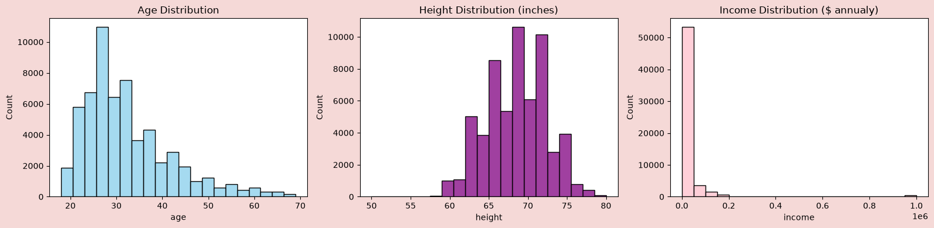
Numeric Data
The numeric data in profiles showed a diverse range of ages, heights and incomes. After removing outliers, we were left with the following distributions.
For this project, we chose to focus on categorical features because machine learning models often struggle with datasets that mix categorical and numerical data, especially without extra preprocessing. Using only categorical features helped us avoid issues with data compatibility.

Slide 9
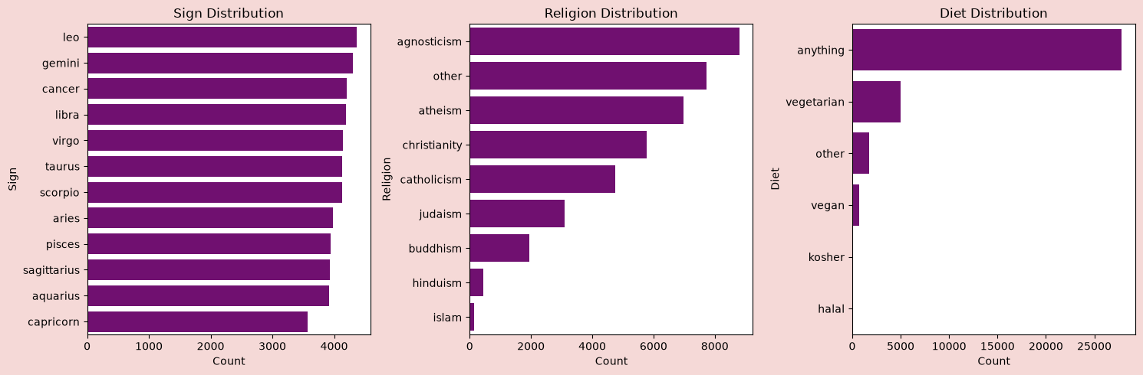
Categorical Data
Some of the categorical columns, such as religion and sign, contained multiple responses that could be summarised into main categories. This was done as part of the EDA step rather than during preprocessing to make visualisations clearer.

Slide 10
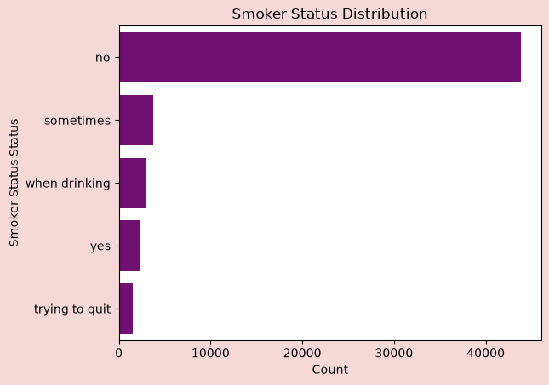
Target Label
Analysis of the smoker column found that most of the users did not smoke, but some smoked conditionally. Since we wanted our models to predict solely whether a user was a smoker or a non-smoker, the multiple responses would be an obstacle to handle during preprocessing.

Slide 11
Key Observations
Age: Most users are in their late 20s to early 30s, with a mean age of about 32 years.
Gender: There are more men than women in the dataset.
Religion, Job, and Zodiac: There is a wide range of religions and job roles among users in the dataset, with unequal distributions. Zodiac signs are relatively equally distributed.
Pets, Offspring and Orientation: Most of the users like both dogs and cats, and most are childless. The majority of users are straight, but other orientations are present.
Status: Most of the users are single, but curiously, there are exceptions.
Smokes: Most of the users do not smoke, but there are a range who do smoke conditionally or otherwise.

Slide 12

Data Preprocessing
Cleaning and processing data

Slide 13
Preprocessing Overview
Data Cleaning
Feature Selection
Target Label Encoding
Train-test Split
One-Hot Encoding
Standardisation
Now that we had sufficient insight on the data in our profiles DataFrame, we moved on to cleaning and preprocessing the data into a format suitable for the machine learning algorithms. This involved the following steps:

Slide 14
Data Cleaning
Nulls
To ensure the data fed to the machine algorithms were not missing data, we removed any rows that contained missing values. This meant that the size of our training data was significantly smaller than it could have been and is a limitation of this project.
Summarised Features
The columns with multiple responses that were similar or could be summarised into main categories were simplified and summarised in the EDA step. This process is considered part of data cleaning.

Slide 15
Feature Selection
Next, we extracted a subset of relevant categorical feature columns from the cleaned profiles DataFrame, focusing on categorical features. We did this because the numerical features, such as height, age and income, posed a risk of introducing bias and noise into the models.
The subset used in this project consisted of the following features:
'sex’
'body_type’
'diet’
'drinks’
'drugs’
'education’
'offspring’
'orientation’
'religion_cleaned'

Slide 16
Feature Preprocessing
Target Label Encoding
The smokes column contained several categories aside from no smoker status. We converted these into a binary label: users who answered no were labelled as non-smokers, while all other responses were labelled as smokers.
Train-test Split
We split the data into features (X) and labels (Y), then used a train-test split to divide the clean dataset into training and validation sets. This was done before encoding and standardising to prevent data leakage between sets.
One-Hot Encoding
For our categorical features, we used one-hot encoding to convert the categorical features into a numeric format that the machine learning algorithms could interpret.
Standardisation
Because logistic regression models are sensitive to feature scale, we created a standardised set of feature data. This helped our logistic regression model learn more effectively and improved its performance.

Slide 17

Model Building
Building and training machine learning models

Slide 18
Building and Training Models
Binomial Logistic regression
K-nearest neigbours classifier
M1
M2
M3
Random Forests Classifier
With the data preprocessed and ready for training, we built three different machine learning algorithms and trained them on the training data. We used hyperparameter tuning for the more complex models to try and improve the accuracy before testing.
The three ML models we used are:

Slide 19
The Models
Logistic Regression
K-Nearest Neighbours
Random Forests

Slide 20
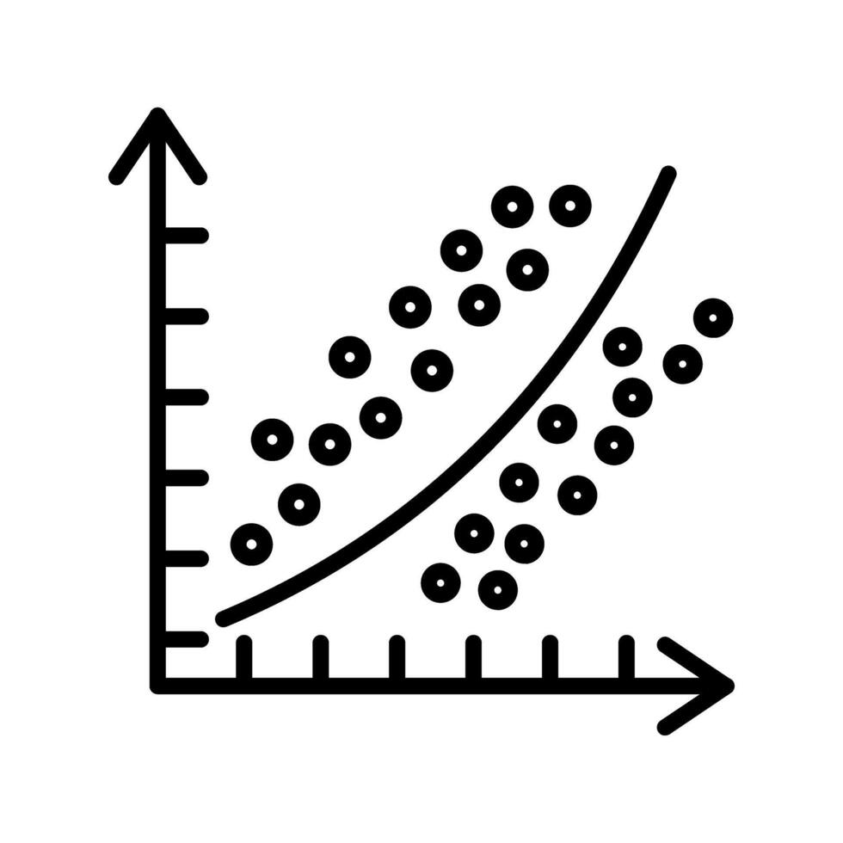
Logistic Regression Model
Our first model used binomial logistic regression, to predict the binary target labels of smoker vs. non-smoker. We used the encoded and standardised data for this model, as logistic regression models are sensitive to feature scale. The logistic regression model was relatively simple compared to the other classifier models.
A binomial logistic regression model predicts the probability that an input belongs to one of two classes. It uses the sigmoid function and weighted sums of input features to generate a probability between 1 (one label) and 0 (the other label) and determine which the input is most likely to be.

Slide 21
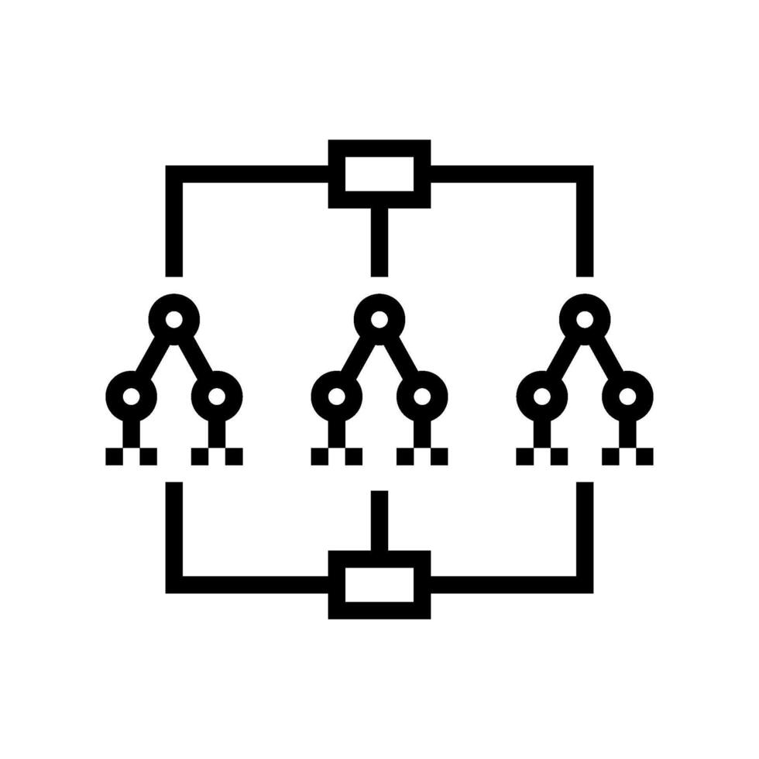
Random Forests Classifier
Our second model used a combination of many decision trees to select a predicted label for each input. Using a technique called hyperparameter tuning, we cycled over multiple values of hyperparameters to select the best number of decision trees for the random forest classifier before building our model.
Random forest classifiers work by building many decision trees, each trained on different parts of the data. Each tree makes its own prediction, and the random forest chooses the final label by taking a majority vote from all the trees. This approach avoids overfitting and tends to improve prediction accuracy.

Slide 22
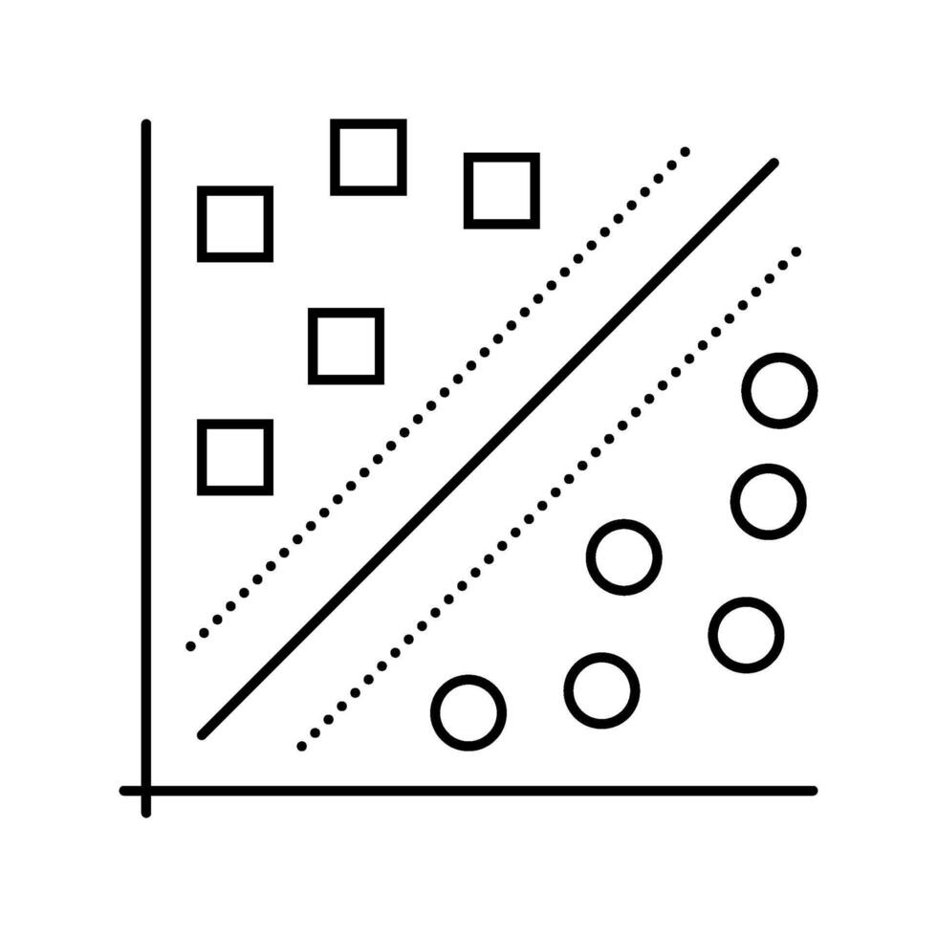
K-Nearest Neighbours Classifier
Our third model predicted smoker status based on the most similar data points to each input. We used the standardised data, as k-nearest neighbours (KNN) models use ‘distance’ to calculate labels and are sensitive to feature scale.
The model predicts labels for each input by looking at the labels of the ‘k-closest’ data points in the training set. The model assigns the most common label among these neighbours to the input. The value of k controls how many neighbours are considered for each prediction. We calculated the optimal K using hyperparameter tuning as we did with the random forest classifier.

Slide 23

Model Evaluation
Evaluating model performance

Slide 24
Testing Models
The three classification models were tested on the test set of data by predicting the smoker status of each entry. These predictions were compared against the actual smoker status of each entry, allowing us to calculate how accurate the models were.
All three models achieved around 0.8 (80%) accuracy. However, the actual correct classifications were not balanced between the two classes. We used confusion matrices to display how many false positives and false negatives the models predicted.

Slide 25
The Models
Logistic Regression
K-Nearest Neighbours
Random Forests

Slide 26
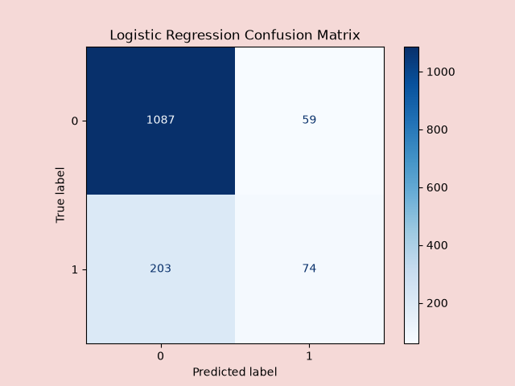
Logistic Regression Model Confusion Matrix
Our binomial logistic regression model was the simplest out of the three. It achieved an accuracy score of 0.82 (82%), the highest out of the three models. The confusion matrix shows that the model predicted class 0 (non-smoker) well, but struggled with class 1 (smoker). The number of false negatives predicted (203) was much higher than the number of true positives predicted (74).

Slide 27

Random Forests Classifier Confusion Matrix
Our random forests model achieved 0.80 (80%) accuracy, the lowest accuracy score out of the three models. The confusion matrix shows that the model predicted class 0 (non-smoker) better than class 1 (smoker) just as the logistic regression model did. This model predicted slightly more false negatives than the logistic regression model.

Slide 28
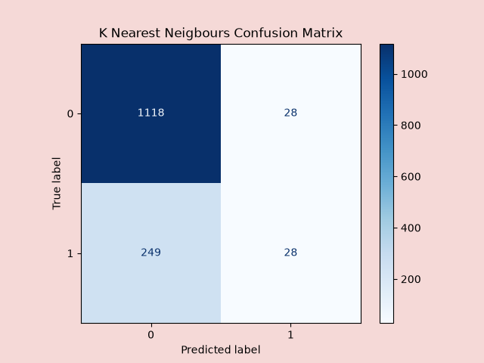
K-Nearest Neighbours Classifier Confusion Matrix
The KNN model achieved 0.81 (81%) accuracy but appeared to have the same difficulty predicting class 1 (smoker) correctly as the previous two models. This model predicted far fewer false positives (28) than true negatives (1118), but also predicted far more false negatives (249) than true positives (28) than the other two models.

Slide 29
Evaluation Summary
Prediction Accuracy
The three models predicted class 0 (non-smoker) very well but struggled with class 1 (smoker). We saw that the overall accuracy was high, but this was mostly due to stronger performance on class 0.​
Model Recall
The low recall for class 1 meant we missed many actual class 1 cases. This showed the models were likely biased towards the majority class, suggesting that our dataset’s features, or at least those we selected, were not predictive of smoker status.​
Best-performing Model
Out of the three models, the logistic regression model had the fewest false positives, as shown by its higher precision for class 1 (0.56). This meant it was less likely to incorrectly predict someone as a smoker when they were not, making it the best performing model out of the three we built.

Slide 30

Conclusion

Slide 31

Conclusion
Our overall analysis supported the null hypothesis: the available features did not strongly predict smoker status.
By implementing machine learning algorithms, we saw that our models predicted non-smoker status well, but struggled with smoker status.

Slide 32
Future Improvement Ideas:
1 | Collect or engineer new features that are more closely related to smoking behaviour.
2 | Address class imbalance using resampling techniques or by gathering more data for the minority class.
3 | Explore alternative machine learning algorithms or ensemble methods that may handle imbalanced data better.
4 | Perform feature selection or dimensionality reduction to identify any hidden patterns.

Slide 33
Links and Credits
codecademy.com/paths/data-science/tracks/dscp-machine-learning-portfolio-project/modules/dscp-group-project-okcupid-date-a-scientist/informationals/dscp-group-project-okcupid-date-a-scientist
nsmith7atafi/OKCupid_Project: Codecademy Build a Machine Learning Model Capstone Project: OKCupid Date-A-Scientist
This project was completed as part of the Codecademy Data Scientist: Machine Learning Specialist career path.
Inspiration for some improvements to the models built in this project were taken from the OKCupid project by nsmith7atafi on GitHub.

Slide 34
Smoking kills. Protect your health.

Slide 35
Thank you.

